Slide 1



PIMPRI CHINCHWAD EDUCATION TRUST’S S.B.PATIL COLLEGE OF Science and Commerce, Ravet
5. SERVER SIDE SCRIPTING (PHP)
Index:
Features of PHP
PHP variables, datatypes
PHP Array, String function and user- defined functions
PHP form handling
From:
Mrs. Shilpa Prashant Kate (IT Teacher)
S.B.Patil college of Science & Commerce,Ravet

Slide 2
Introduction to php
PIMPRI CHINCHWAD EDUCATION TRUST’S S.B.PATIL COLLEGE OF Science and Commerce, Ravet
PHP stands for Hypertext Preprocessor.
It is widely used open source general purpose scripting language.
It is widely used for web development and can be embedded with HTML.
PHP scripts are executed on the server.
PHP is free to download and use.
PHP runs on various platform like LINUX, UNIX,Mac OS, Windows etc.
It is compatible for almost all servers used today like XAMMP, Apache, NGINX, lighttpd.
It supports wide range of databases.
PHP is easy to learn and runs efficiently on the server side.
PHP is free to download and one can download it from the official website www.php.net

Slide 3
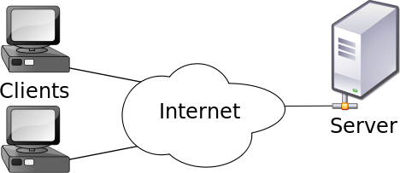
Server side scripting
PIMPRI CHINCHWAD EDUCATION TRUST’S S.B.PATIL COLLEGE OF Science and Commerce, Ravet
A server is a computer system that serves as a central repository of data and programs and is shared by all clients.
The server side environment that runs a scripting language is termed as web server.
Server-side scripting as it relates to web pages usually refers to PHP code that is executed on the web server before the data is passed to the user's browser.
In the case of PHP, all PHP code is executed server-side and no PHP code ever reaches the user.
After the PHP code is executed, the information it outputs is embedded in the HTML, which is sent to the viewer's web browser.
It is usually used to provide interactive web sites that interfaces with databases or other data stores on the server.
Few server-side scripting languages are PHP, Java & JSP, Python.

Slide 4
PIMPRI CHINCHWAD EDUCATION TRUST’S S.B.PATIL COLLEGE OF Science and Commerce, Ravet
PHP mainly focuses on server-side scripting , which is used to collect form data, generate dynamic page content or send and receive cookies.
Dynamic Page: A dynamic web page is a web page that displays different content each time it's viewed. For example, the page may change with the time of day, the user that accesses the webpage, or the type of user interaction.
Cookies: An HTTP cookie (also called web cookie, Internet cookie, browser cookie, or simply cookie) is a small piece of data stored on the user's computer by the web browser while browsing a website.

Slide 5
FEATURES OF PHP
PIMPRI CHINCHWAD EDUCATION TRUST’S S.B.PATIL COLLEGE OF Science and Commerce, Ravet
Simple: It is very simple and easy to use as compared to other scripting languages.
Interpreted: It is an interpreted language i.e no need of compilation.
Faster: It is faster than other scripting language e.g JSP & ASP
Open Source: It means you will not pay money to use it .You can freely download and use it.
Platform Independent: It will run on all platform like Linux, Unix, Mac OS, Windows.
Case Sensitive: It is case sensitive when you declare variables.
All keywords(echo , if, else etc) ,classes, functions and user-defined functions are not case-sensitive.
Error Reporting: PHP has some pre-defined error reporting constants to generate a warning or error notice.
Real Time Monitoring: PHP provides access logging by creating summary of recent accesses for the user.
Loosely Typed Language: PHP allows you to use variable without declaring its data type. It will be taken at the time of execution , based on the type, data has its value.

Slide 6
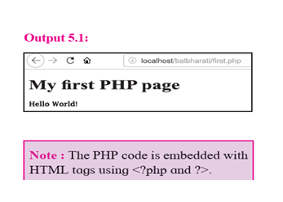
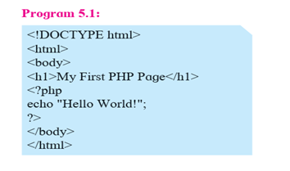
FIRST SAMPLE CODE OF PHP
PIMPRI CHINCHWAD EDUCATION TRUST’S S.B.PATIL COLLEGE OF Science and Commerce, Ravet
A php file normally contains HTML tags and some PHP scripting code.
It is usually enclosed in special start and end tag processing instructions. <?php …. ?> which allows us to move into and out of php mode.
Even it allows to embed HTML with PHP.
Extension of php is”.php”
PHP script can be placed anywhere in HTML document.
OUTPUT

Slide 7
HOW TO EXECUTE PHP CODE
PIMPRI CHINCHWAD EDUCATION TRUST’S S.B.PATIL COLLEGE OF Science and Commerce, Ravet
Type the above program and save it as “first.php” using any text editor like notepad, gedit.
Save the file in C:/XAMPP/htdocs/first.php.
Go to the browser and type http://localhost/first.php
PHP CASE SENSITIVITY
In PHP “Variables ”are case sensitive.
However keywords, functions, class name are not case sensitive.

Slide 8
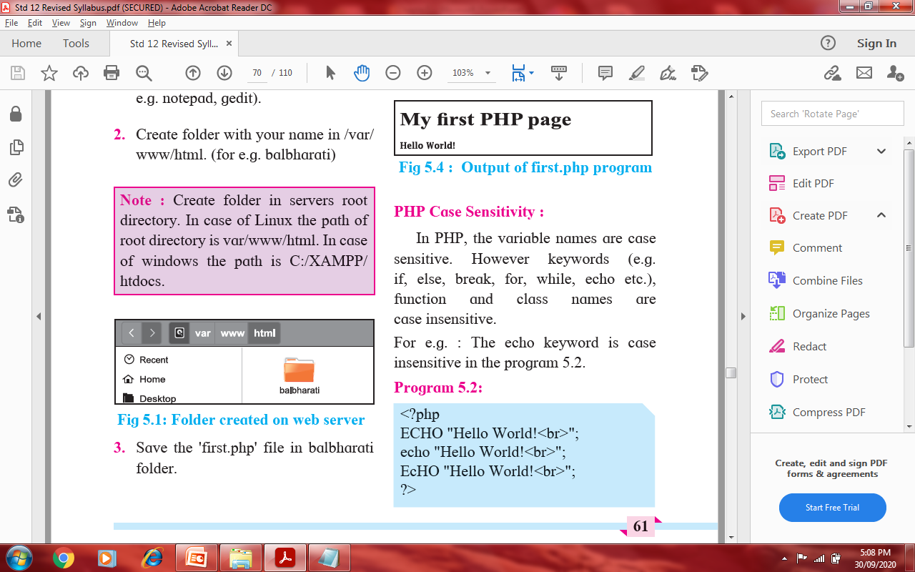
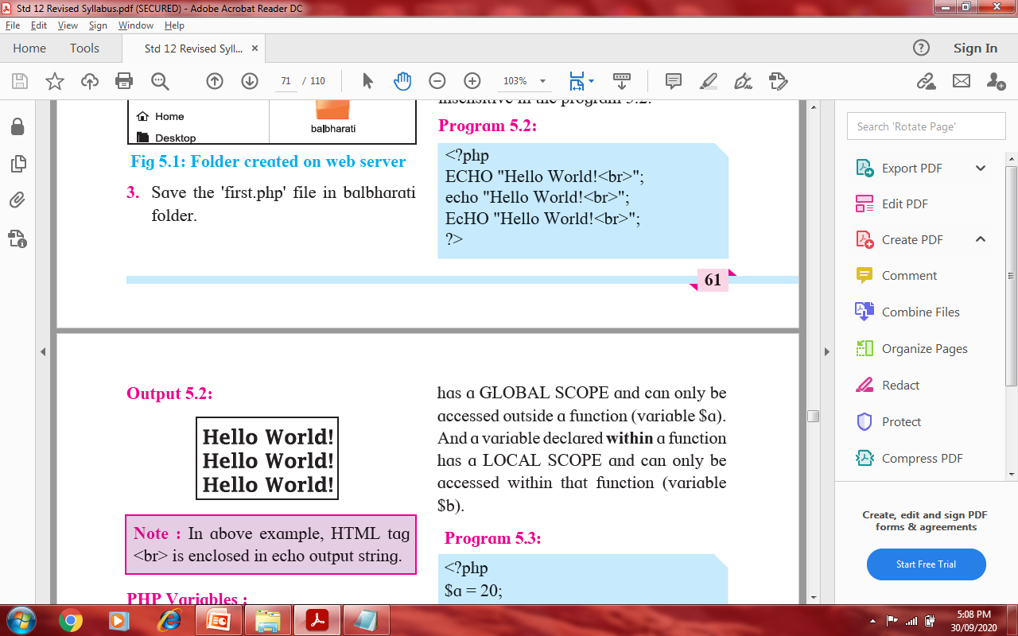
HOW TO EXECUTE PHP CODE
PIMPRI CHINCHWAD EDUCATION TRUST’S S.B.PATIL COLLEGE OF Science and Commerce, Ravet
First.php
Go to the browser and type http://localhost/first.php

Slide 9
PHP VARIABLES
PIMPRI CHINCHWAD EDUCATION TRUST’S S.B.PATIL COLLEGE OF Science and Commerce, Ravet
Variable is a symbol or name that stands for a value.
Variables are used for storing values such as numeric, characters, strings or memory addresses, so that they can be used in any part of program.
RULES FOR DECLARING VARIABLES
Variable starts with $ sign, followed by name of the variable.
A variable name must start with a letter or underscore character.
A variable name cannot start with a number.
A variable name can only contain alpha-numeric characters and underscores(A- z,0-9 and _[underscore]) .
Variable names are case-sensitive. (Eg. $age and $AGE are considered different).

Slide 10
PIMPRI CHINCHWAD EDUCATION TRUST’S S.B.PATIL COLLEGE OF Science and Commerce, Ravet
SCOPE OF VARIABLES IN PHP
Local: A variable declared within a function has local scope and can be accessed within that function.
Global: A variable declared outside the function has a global scope and can only be accessed outside the function.
Static: When a function is executed , then all of its variables are deleted. If you want a local variable not to be deleted then use must use static keyword.
Comments
Comments :-are not visible in the output of the program as it is ignored during the execution.
A single line comments is given by // or # before the PHP statement and a multi-line comment is possible by /*…*/

Slide 11
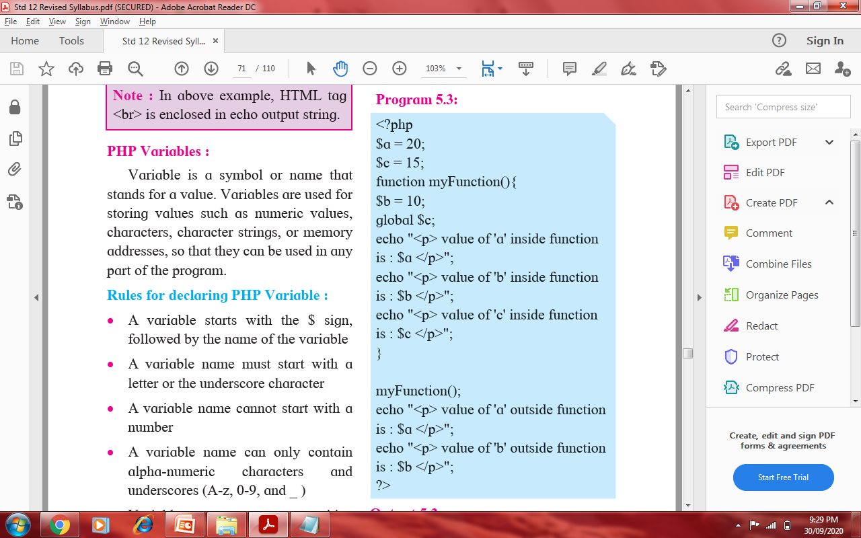
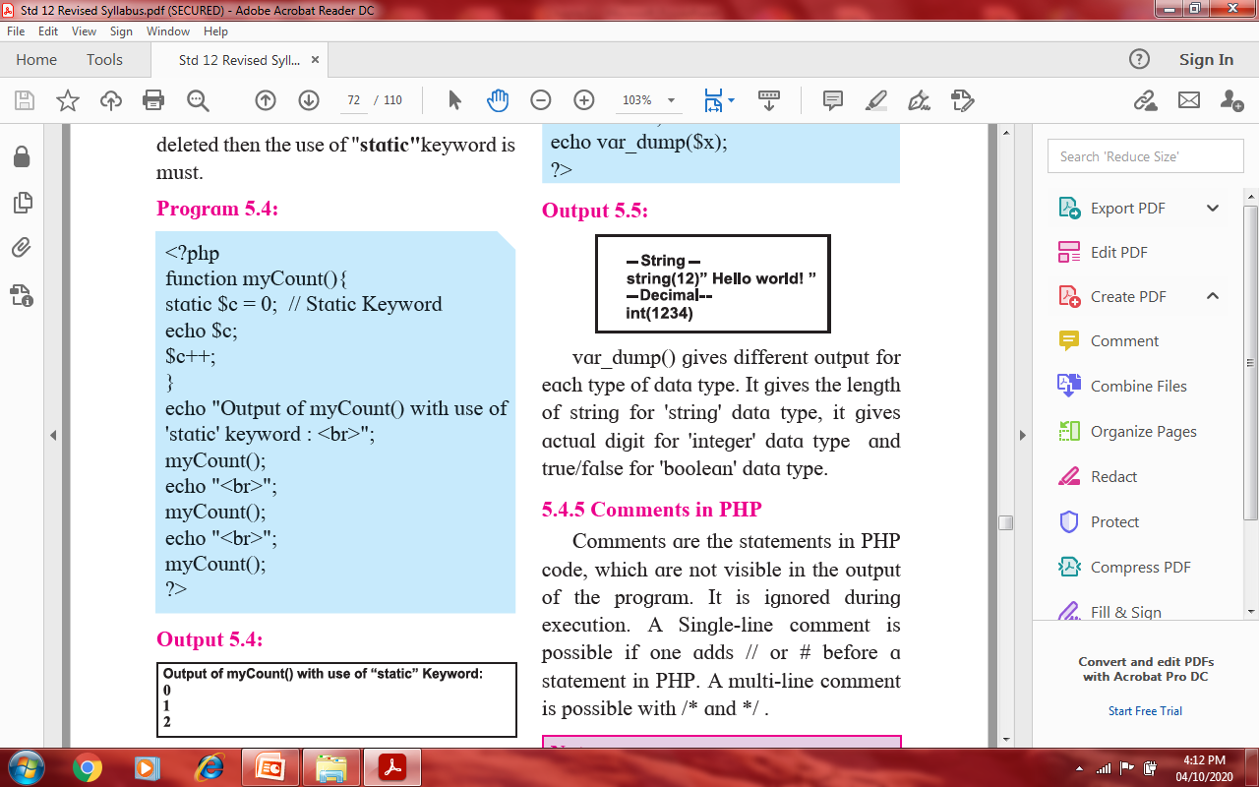
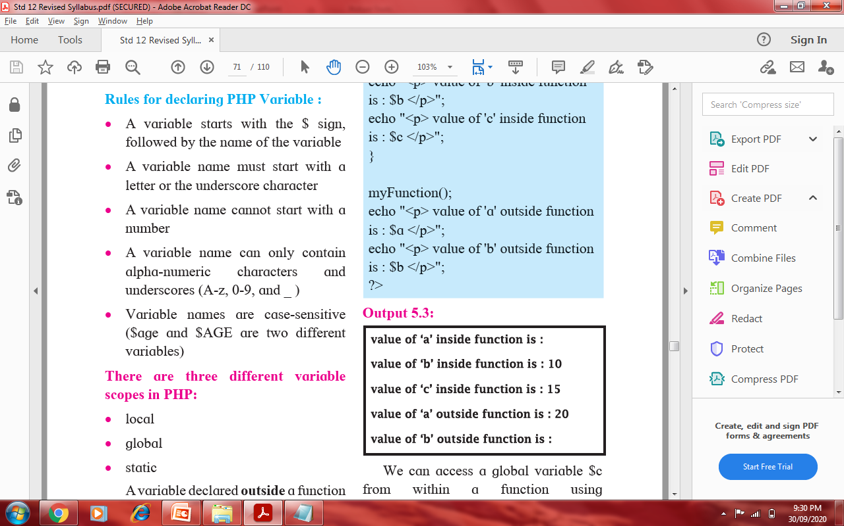
PIMPRI CHINCHWAD EDUCATION TRUST’S S.B.PATIL COLLEGE OF Science and Commerce, Ravet
SCOPE OF VARIABLES IN PHP

Slide 12
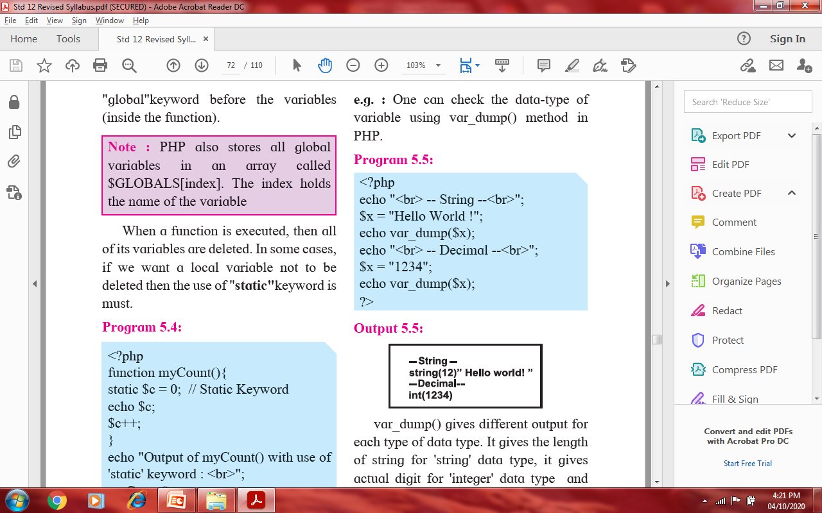
PIMPRI CHINCHWAD EDUCATION TRUST’S S.B.PATIL COLLEGE OF Science and Commerce, Ravet
PHP DATA TYPES
PHP can store data of different types and PHP supports following data types:
String
Integer
Float
Boolean
Array
NULL
One can check the data_type of variable using var_dump() method in PHP.
var_dump() gives different output for each data_type.
It gives length of the string for “string” data_type.
It gives actual value of integer for “integer” data_type.
It gives true/false for “boolean” data_type

Slide 13
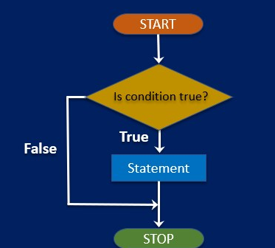
PIMPRI CHINCHWAD EDUCATION TRUST’S S.B.PATIL COLLEGE OF Science and Commerce, Ravet
CONTROL STRUCTURES IN PHP
If statement : if statement allows programmer to make decision, based on one or more conditions; and execute a piece of code conditionally.
Syntax :
if(condition)
{
block of statement;
}
2. If-else statement: if-else statement allows programmer to make decision based on either this or that conditions.
2. If-else statement: if-else statement allows programmer to make decision based on either this or that Syntax: if(condition)
{
statement;
}
else
{
statement
}

Slide 14
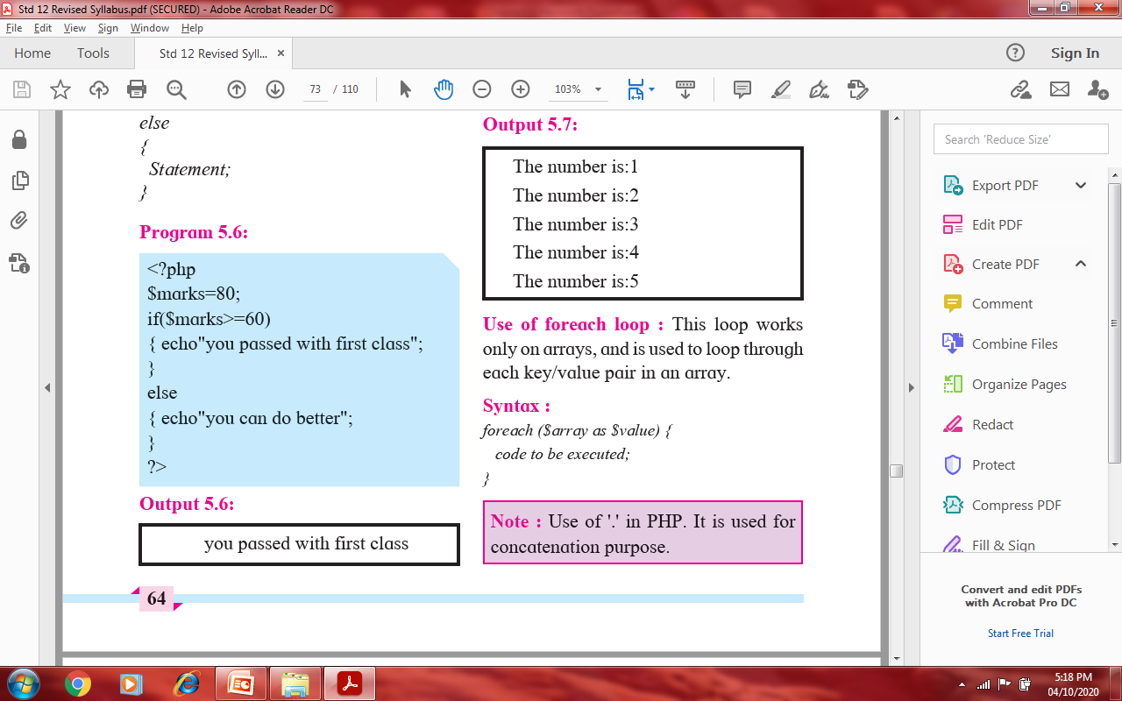
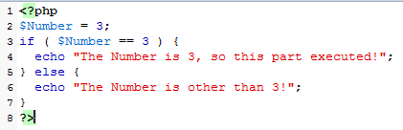
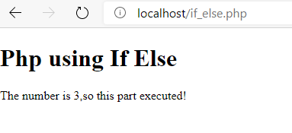
PIMPRI CHINCHWAD EDUCATION TRUST’S S.B.PATIL COLLEGE OF Science and Commerce, Ravet
CONTROL STRUCTURES IN PHP
Program
Output

Slide 15
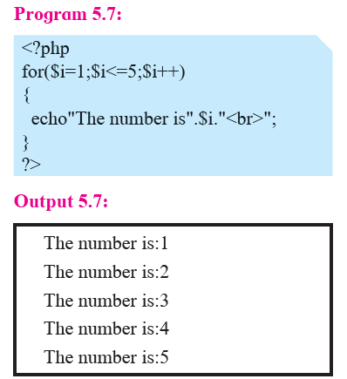
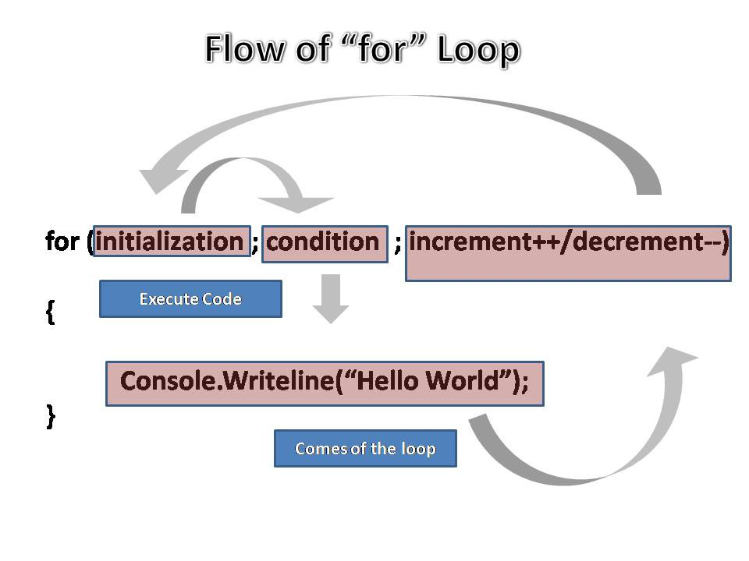
PIMPRI CHINCHWAD EDUCATION TRUST’S S.B.PATIL COLLEGE OF Science and Commerce, Ravet
for…….loop
Loops are used to execute the same block of code repeatedly as long as a certain condition is satisfied.
This loop executes statements as long as condition becomes true, for-loop is that it combines initialization, condition and loop iteration (increment or decrement) in single statement.
Syntax :
code to be executed

Slide 16
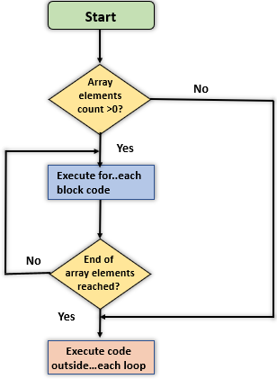
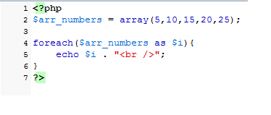
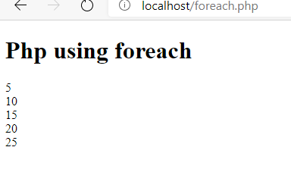
PIMPRI CHINCHWAD EDUCATION TRUST’S S.B.PATIL COLLEGE OF Science and Commerce, Ravet
foreach…….loop
foreach loop: This loop work only on arrays, and is used to loop through each key/value pair in array.
Syntax: foreach($array as $value)
{
code to be executed;
}
NOTE: (.) is used for concatenation purpose.
Output

Slide 17
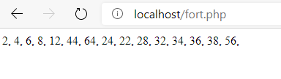
PIMPRI CHINCHWAD EDUCATION TRUST’S S.B.PATIL COLLEGE OF Science and Commerce, Ravet
foreach…….loop
<?php
$array1 = array(1, 2, 3, 4, 6, 22, 32, 12, 11, 14, 16, 17, 18, 19, 28);
foreach ($array1 as $value1) {
$value1 = $value1 * 2;
echo $value1.", ";
}
?>
Output

Slide 18
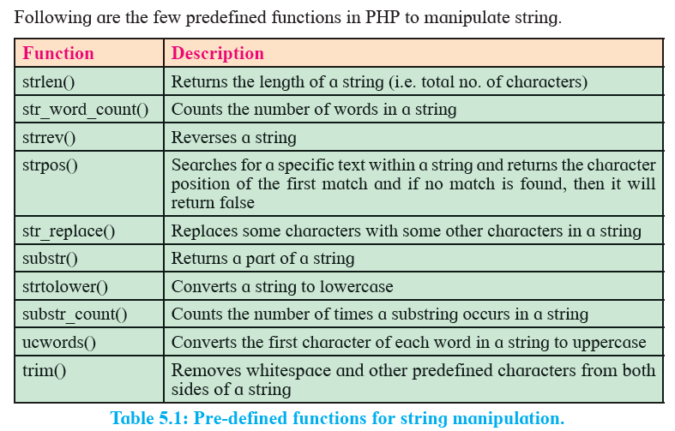
PIMPRI CHINCHWAD EDUCATION TRUST’S S.B.PATIL COLLEGE OF Science and Commerce, Ravet

Slide 19
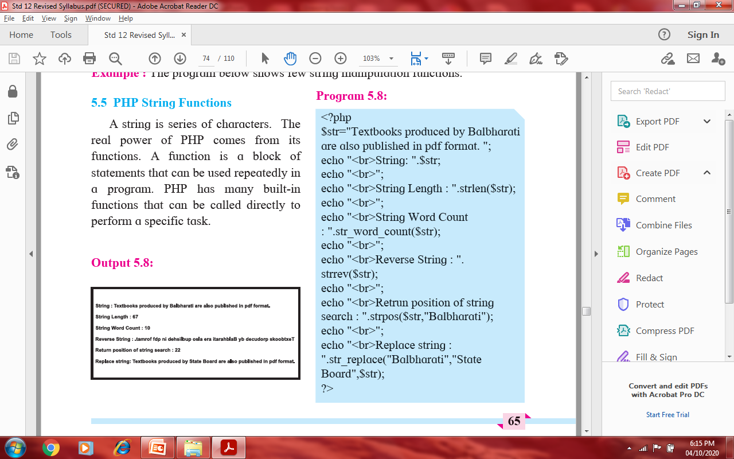
PIMPRI CHINCHWAD EDUCATION TRUST’S S.B.PATIL COLLEGE OF Science and Commerce, Ravet
PHP STRING FUNCTION
A string is series of character.
The real power of PHP comes from its functions.
A function is block of statement used repeatedly in a program.
PHP has many built-in functions which can be called directly to perform a specific task.

Slide 20
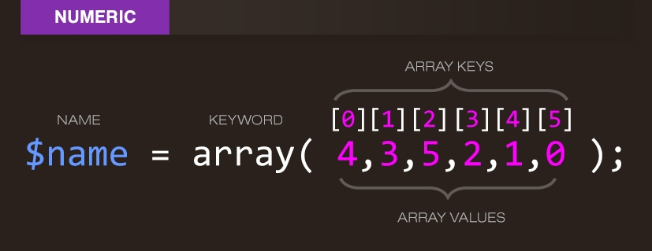
PIMPRI CHINCHWAD EDUCATION TRUST’S S.B.PATIL COLLEGE OF Science and Commerce, Ravet
PHP ARRAY
An array is a special variable which can hold more than a value at a time.
An array stores multiple values in one single variable.
The index can be assigned automatically.(index always starts with 0)
Syntax: $array_name=array(value1,value2,……., value n)
$cars = array("Volvo", "BMW", "Toyota");
$cars[0]= Volvo
$cars[1]= BMW
$cars[2]= Toyota
There are 3 types of arrays
Indexed arrays - Arrays with a numeric index
Associative arrays - Arrays with named keys
Multidimensional arrays - Arrays containing one or more arrays

Slide 21
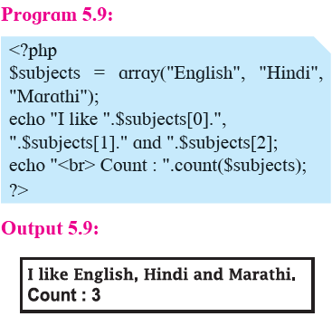
PIMPRI CHINCHWAD EDUCATION TRUST’S S.B.PATIL COLLEGE OF Science and Commerce, Ravet
In this example , we store subject is an array at following index location.
$subject[0]=“English”
$subject[1]=“Hindi”
$subject[2]=“Marathi”
count() function is used to return the Length of array

Slide 22
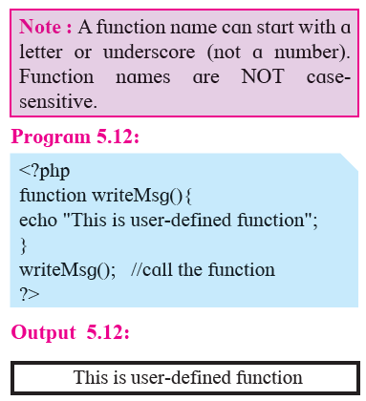
PHP USER DEFINED FUNCTIONS
PIMPRI CHINCHWAD EDUCATION TRUST’S S.B.PATIL COLLEGE OF Science and Commerce, Ravet
A function is block of statement used repeatedly in a program.
It will not execute immediately when a page loads but will be executed by a call to the function.
Along with built-in PHP functions we can create our own functions.
User-defined function starts with the word function.
Information can be passed to functions through arguments.
An argument is just a variable.
Arguments are specified after the function name, inside brackets.
Syntax: function fun_name()
{
code to be executed
}

Slide 23
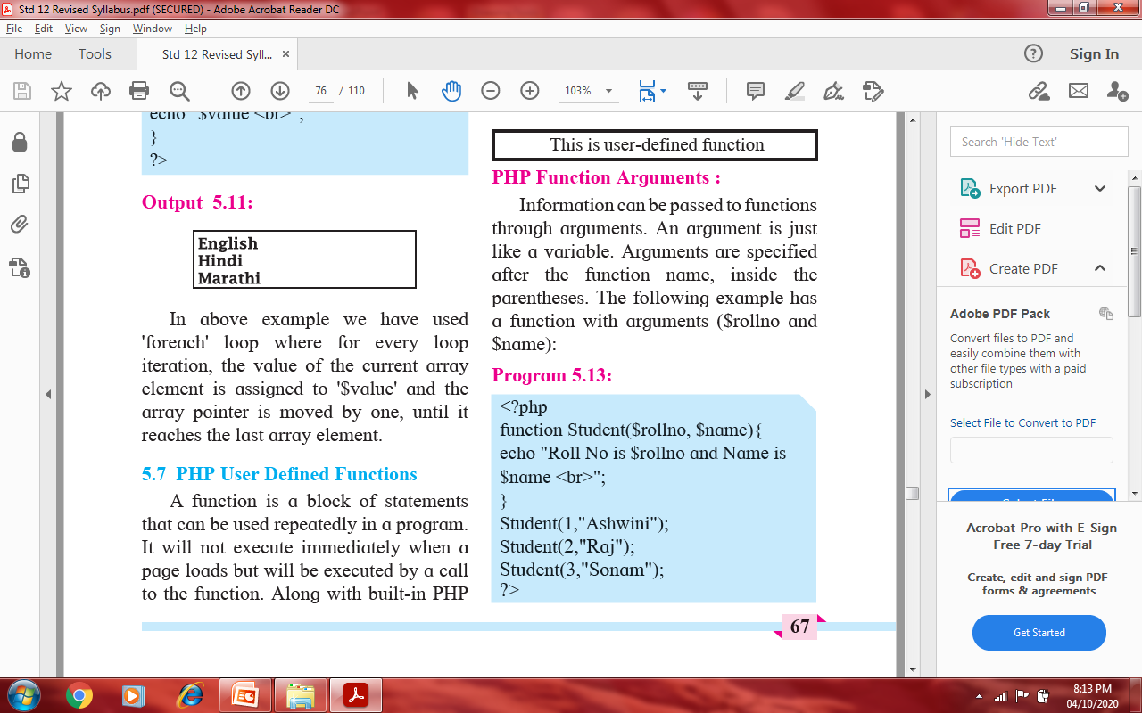
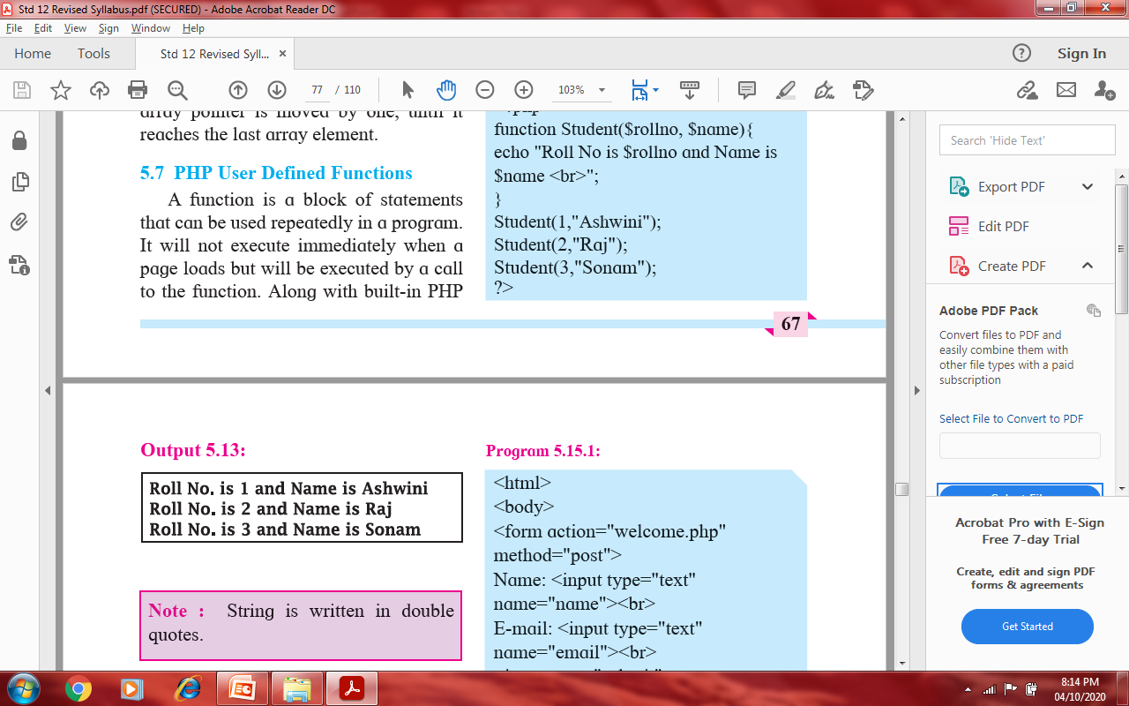
PIMPRI CHINCHWAD EDUCATION TRUST’S S.B.PATIL COLLEGE OF Science and Commerce, Ravet

Slide 24
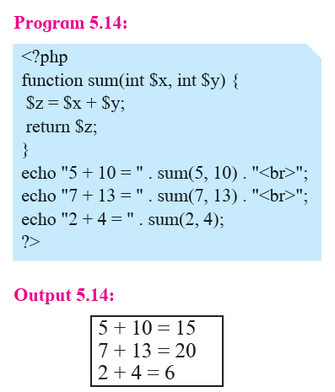
PIMPRI CHINCHWAD EDUCATION TRUST’S S.B.PATIL COLLEGE OF Science and Commerce, Ravet
Use return statement to return a value.
Note : 'language' attribute of <Script> is replaced by 'type' attribute in all the programs as it is standardized.

Slide 25
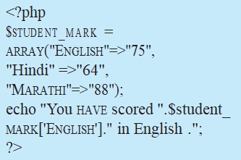
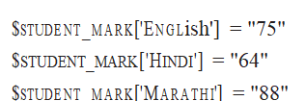
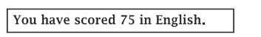
PIMPRI CHINCHWAD EDUCATION TRUST’S S.B.PATIL COLLEGE OF Science and Commerce, Ravet
PHP Associative Arrays :
Associative arrays are arrays that use named keys instead of index to identify record/value.
Let us see how to create associative array.
Syntax :
$a = array( key1 => value1, key2=>value2, ...,key n => value n)
values of ‘student_mark’ array are stored in following way:

Slide 26
PIMPRI CHINCHWAD EDUCATION TRUST’S S.B.PATIL COLLEGE OF Science and Commerce, Ravet
When to use GET?
Information send from a form using GET method is visible to everyone.(names and values of variables are displayed on URL)
It also has limit on amount of information to send. Because the variables are displayed in the URL ,it is possible to bookmark the page.
It may be used to send some non-sensitive data.
It should never be used to for sending passwords or other sensitive information.

Slide 27
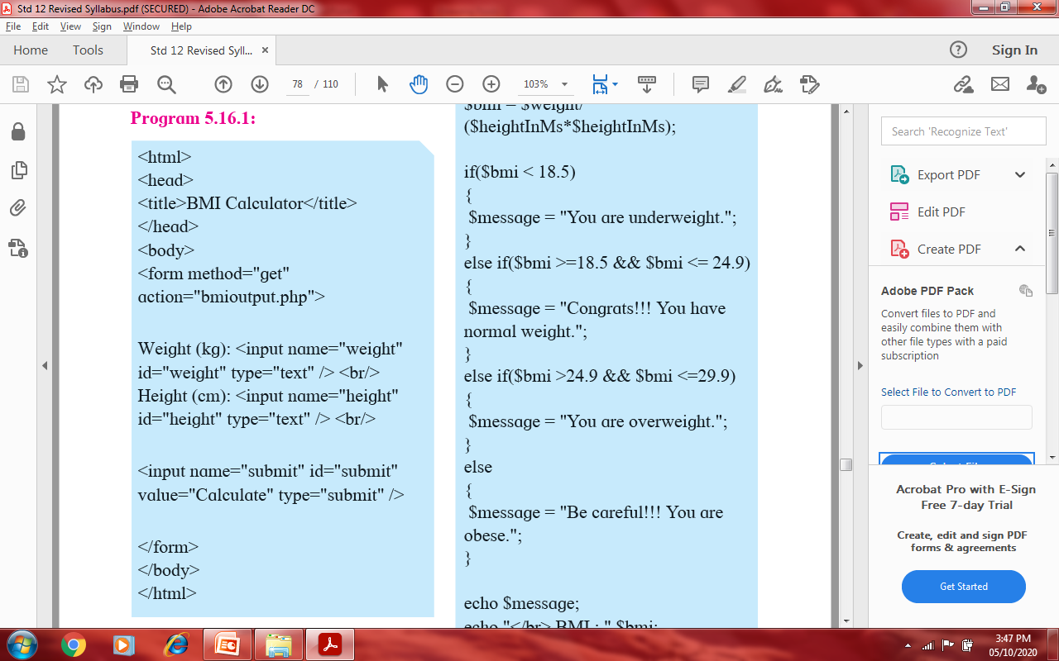
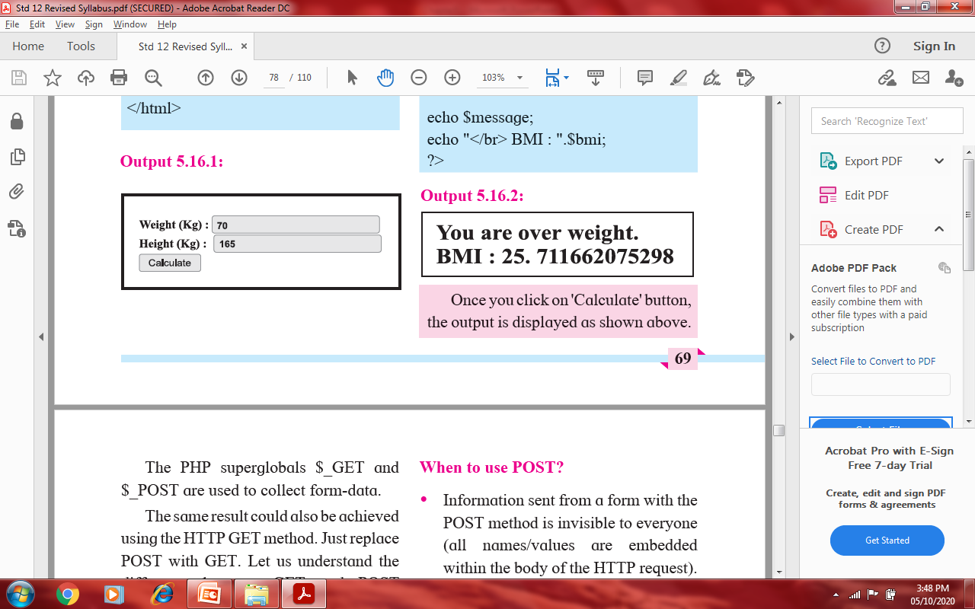
PIMPRI CHINCHWAD EDUCATION TRUST’S S.B.PATIL COLLEGE OF Science and Commerce, Ravet
Let us see one program on “get” method

Slide 28
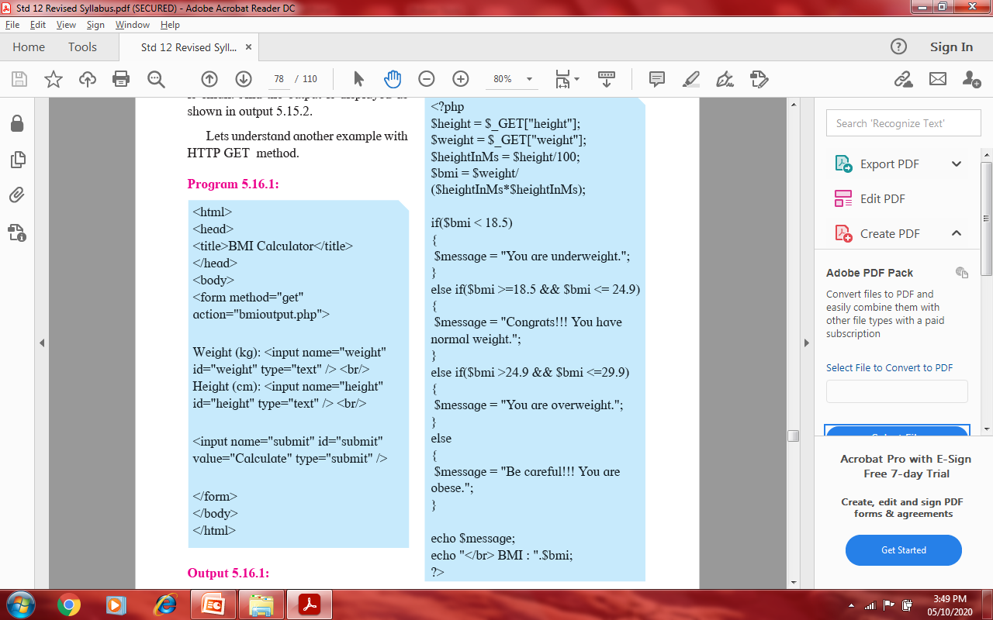
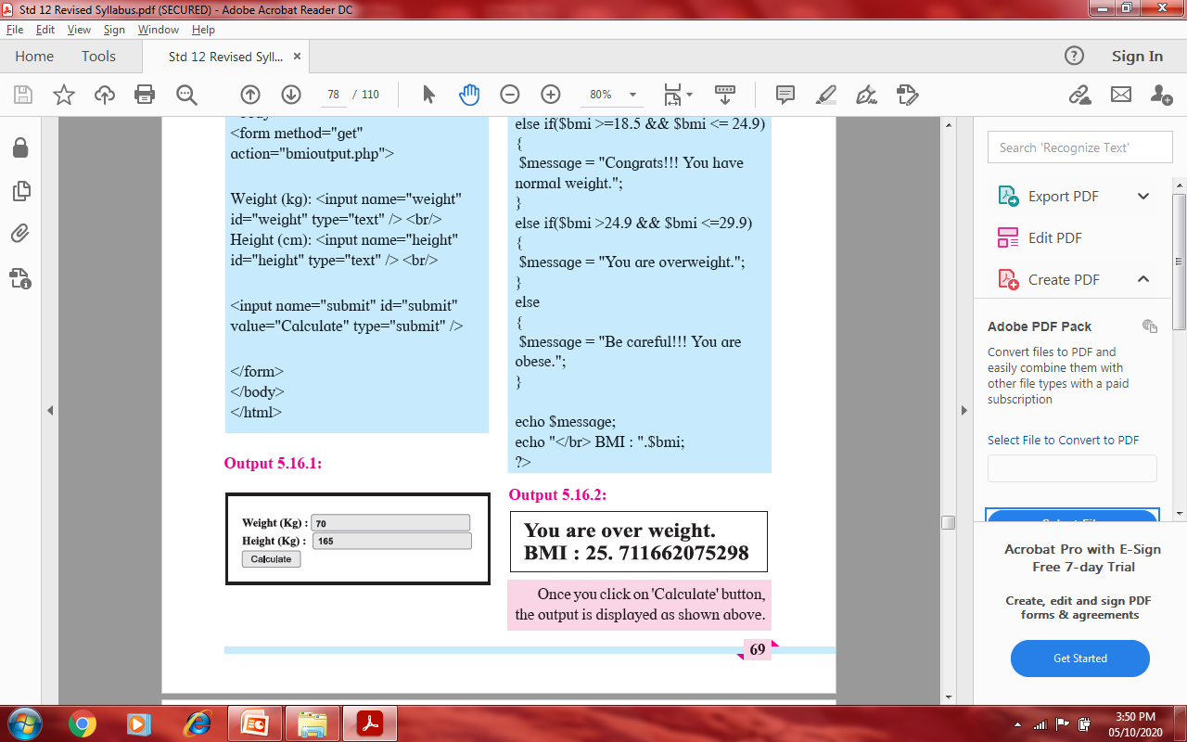
PIMPRI CHINCHWAD EDUCATION TRUST’S S.B.PATIL COLLEGE OF Science and Commerce, Ravet

Slide 29
PIMPRI CHINCHWAD EDUCATION TRUST’S S.B.PATIL COLLEGE OF Science and Commerce, Ravet
When to use POST?
Information send from a form using POST method is invisible to everyone.(all names and values are embedded within the body of the HTTP request.)
It has no limit on amount of information to send.
Moreover POST supports advanced functionality such as support for multi-part binary input while uploading files to the server.
The variables are not passed in the URL so it is possible to bookmark the page.

Slide 30
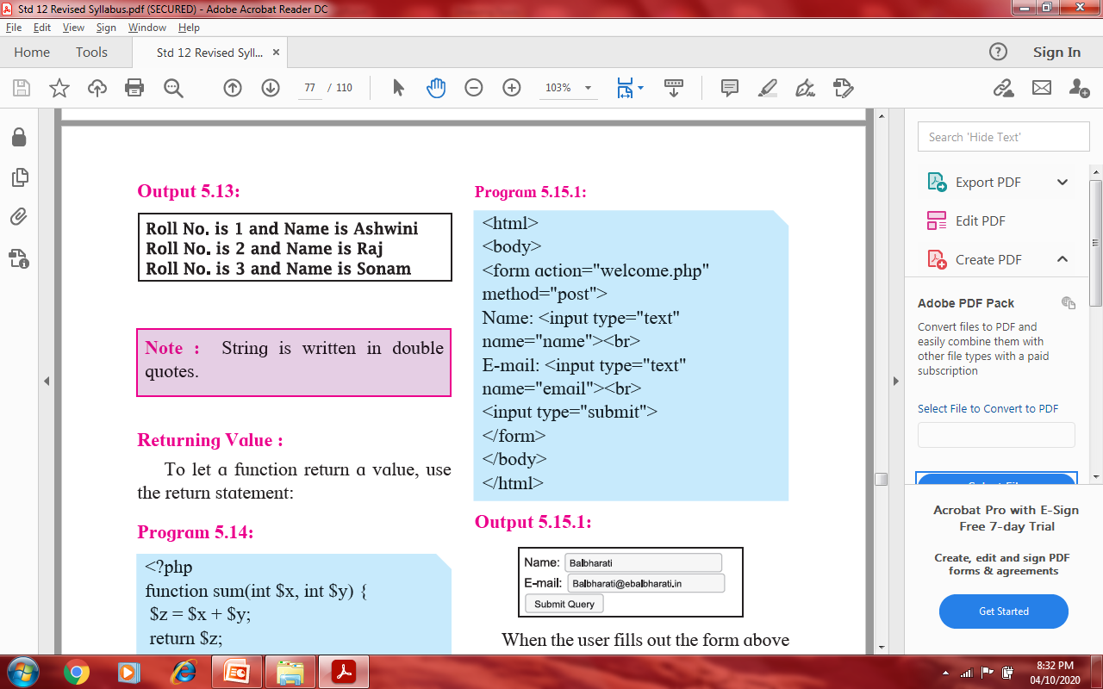
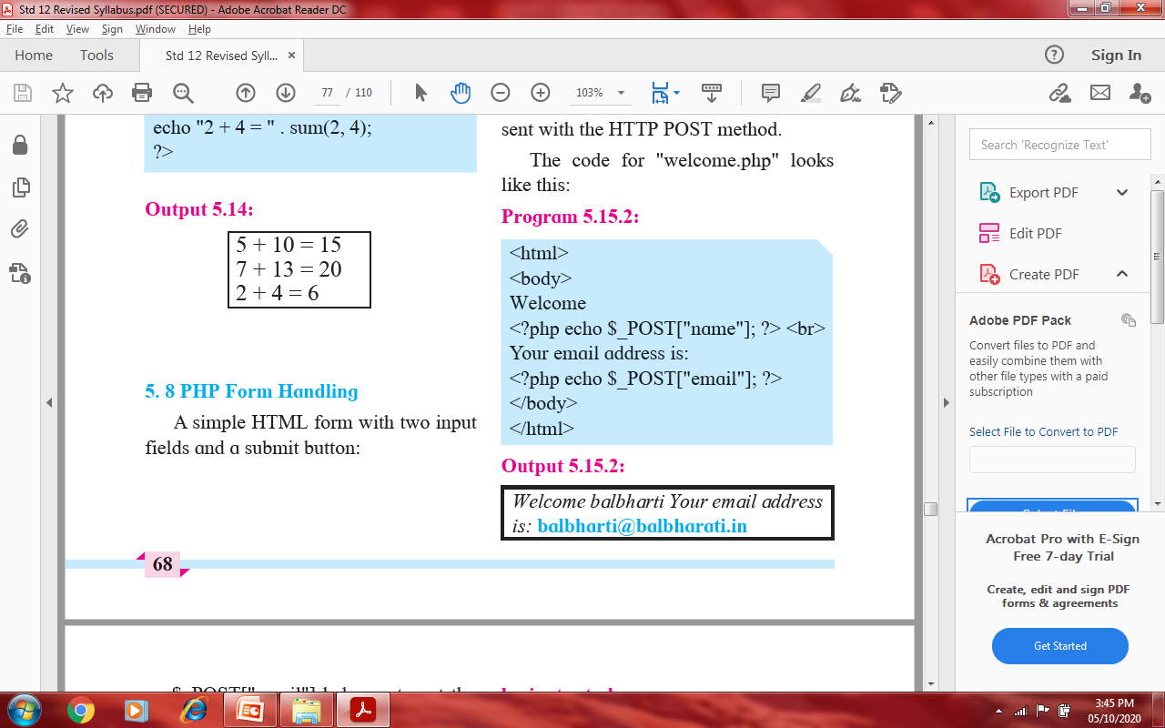
PIMPRI CHINCHWAD EDUCATION TRUST’S S.B.PATIL COLLEGE OF Science and Commerce, Ravet
A simple HTML form with 2 input fields and submit button code is as follows:
Note : 'language' attribute of <Script> is replaced by 'type' attribute in all the programs as it is standardized.

Slide 31
PIMPRI CHINCHWAD EDUCATION TRUST’S S.B.PATIL COLLEGE OF Science and Commerce, Ravet
When user fills out the form above and clicks the submit button , the form data is sent for processing to a PHP file names “welcome .php”.
The form data is sent with the HTTP POST method.
The code for “welcome.php” looks like this

Slide 32
PIMPRI CHINCHWAD EDUCATION TRUST’S S.B.PATIL COLLEGE OF Science and Commerce, Ravet
GET vs POST
Both GET and POST are treated as $_GET and $_POST super globals, which means they are accessible ,regardless of scope.
It can be accessed from function ,class or file without having to do anything special.
$_GET is an array of variables passed via the URL parameters.
$_POST is an array of variables passed via the HTTP POST method.

Slide 33
PIMPRI CHINCHWAD EDUCATION TRUST’S S.B.PATIL COLLEGE OF Science and Commerce, Ravet
Summary
PHP is widely-used open source server-side programming language which runs on various platforms.
PHP is a script executed on server which generate dynamic HTML pages.
The PHP code can also be embedded with HTML tags using <?php and ?>.
PHP is case sensitive only at time of variable declaration and not-case sensitive for other keywords.
PHP variable start with $ sign followed by name of variable which must start with a alpha-numeric characters or underscore character.
PHP variable has three different scopes namely : local, global and static.
PHP supports String, Integer, Float, Boolean, Array and NULL data types.
Three types of Arrays are Indexed array, Associative array and Multi-dimensional array.
PHP supports ‘foreach’ loop to iterate easily.
String functions are used to manipulate strings.

Slide 34
PIMPRI CHINCHWAD EDUCATION TRUST’S S.B.PATIL COLLEGE OF Science and Commerce, Ravet
Summary
A function is a block of statements that can be used repeatedly in a program.
Information can be passed to functions through arguments.
Form is used to collect information from user and process or store in database.
Form data can be submitted by GET or POST method.
The PHP superglobals $_GET and $_POST are used to collect form-data.
$_GET is an array of variables passed via the URL parameters and are visible to everyone.
$_POST is an array of variables passed via the HTTP POST method and are invisible to others.
GET has limits on the amount of information to send whereas POST has no limits on the amount of information to send.
GET should NEVER be used for sending sensitive information.
Cookies are sent along when browser requests server pages.
Session helps web application to maintain user information on all the pages.

Slide 35
PIMPRI CHINCHWAD EDUCATION TRUST’S S.B.PATIL COLLEGE OF Science and Commerce, Ravet
Thank you !

